Slide 1
The Quest
Team Durian
OOP Team Project
Software University, Sofia
March 2015

Slide 2
Basic info
GitHub: https://github.com/TeodorPopoff/OOP-Teamwork
Team:
Strahil Ruychev
Vasil Nikolov
Dimitar Stoyanov
Teodor Popov

Slide 3
The idea
Our game is based on the story in the popular book by J.R.R Tolkien - The Hobit (and the corresponding movie trilogy)
Our main character - the Dwarf King Thorin starts an adventure looking to reclaim the treasures of his ancestors from the evil dragon Smaug
Thorin has to cross a computer-generated field (middle earth) filled with various other characters and things - both friends and enemies
On his way, his team can join other dwarfs or friends like elves and magicians
The team also faces enemies, such as trolls, orcs and goblins and has to fight them

Slide 4
Basic Functionality
The game starts with the main character positioned in the upper left corner of middle earth
Character is moved around the field using the arrow keys
Other dwarves are marked with D and can be joined to the team if there is a clear path to them
Marked with * are other character and items - both friendly or dangerous
When an enemy is encountered the team has to fight it
or fly / ride away - if such ability has been previously acquired
When the team reaches the lower right corner of the filed - the game is won

Slide 5
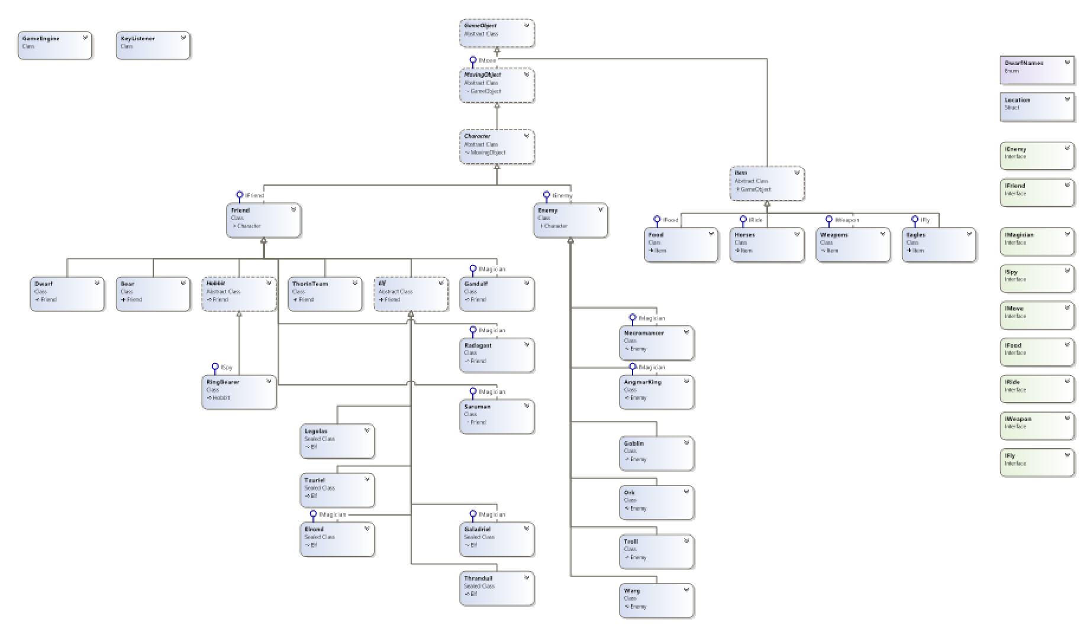
Class diagram

Slide 6
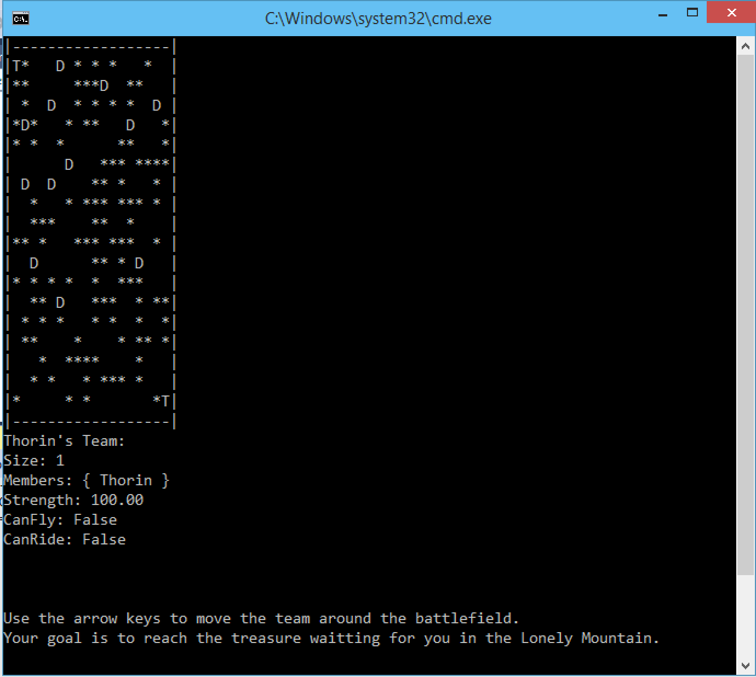

Slide 7
technologies used
Visual Studio, C#
GitHub

Slide 8
Thanks for your attention…
Team durian

